Slide 1
Examining the relationship between manatee physiology and environment and manatee death by watercraft collision.
Steven Layne
Manatee Enthusiast

Slide 2
Variable Reduction
Dates -> Seasons
Counties -> Regions

Slide 3
Null Hypothesis
H0: The occurrence of collisions in manatees does not differ with size, sex, region or season.
Notes:
The occurrence of collisions in manatees does not differ with combinations of the size, sex, region or season where they may be independent of one another or interact.

Slide 4
GLM Based Analyses
4 Explanatory Variables
Sex: Categorical
Region: Categorical
Season: Categorical
Size(cm): Continuous
Bionomial Response
Collision: True/False

Slide 5
Choosing Model(MumIN)
.....
.....
.....
.....
.....
.....
.....
.....

Slide 6
Choosing Model(StepAIC)

Slide 7
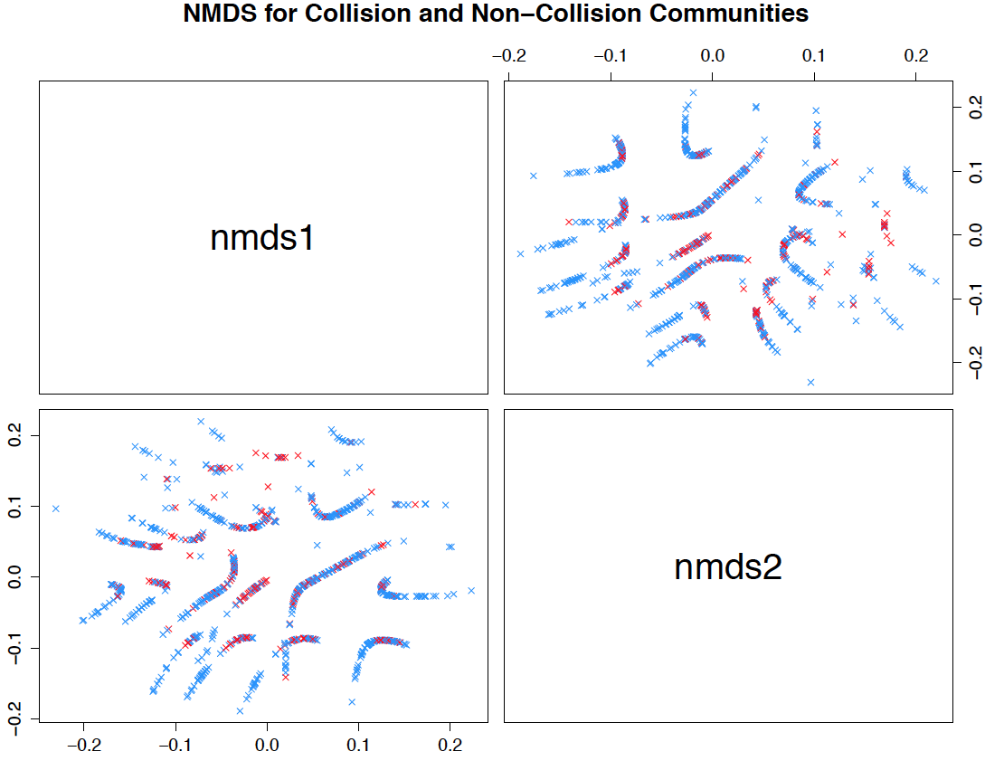
NDMS

Slide 8
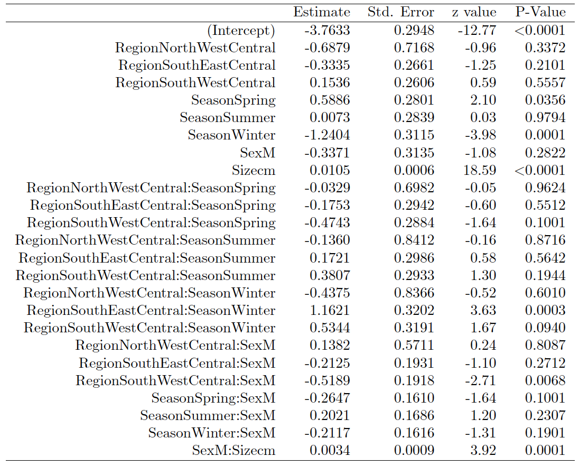

Slide 9
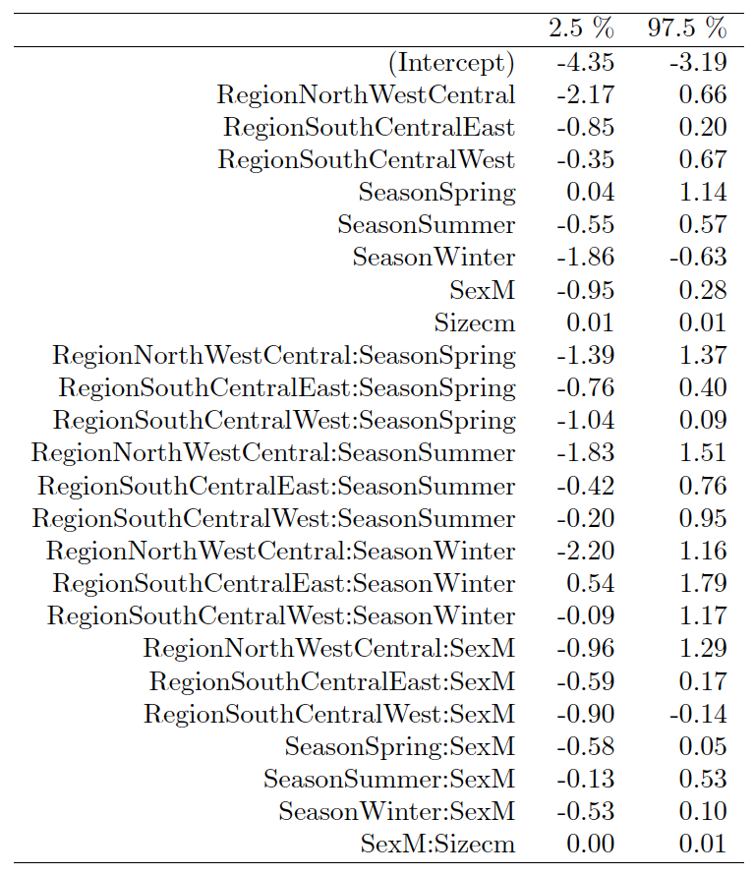
Confidence Interval for Parameters

Slide 10
Citations
R Core Team (2015). R: A language and environment for statistical computing. R Foundation for Statistical Computing, Vienna, Austria. URL https://www.R-project.org/.

